Slide 1

‘Unseen disabilities’
Name of practitioner-researcher: Michael Ste.Croix
m.stecroix0920231@arts.ac.uk
​​

Slide 2

My Positionality
We, as teachers, move among the student community and are not aware of the ‘unseen’ issues that students are facing. I would like to address this ‘unseen’ barrier that prevents ‘inclusivity’ for all. I intend to pursue this with rigour, with the use of a ‘teaching tool’ that will aid a student to reveal their unseen disability in an environment that does not cause embarrassment but with the aim to help and support them at Central Saint Martins.

Slide 3
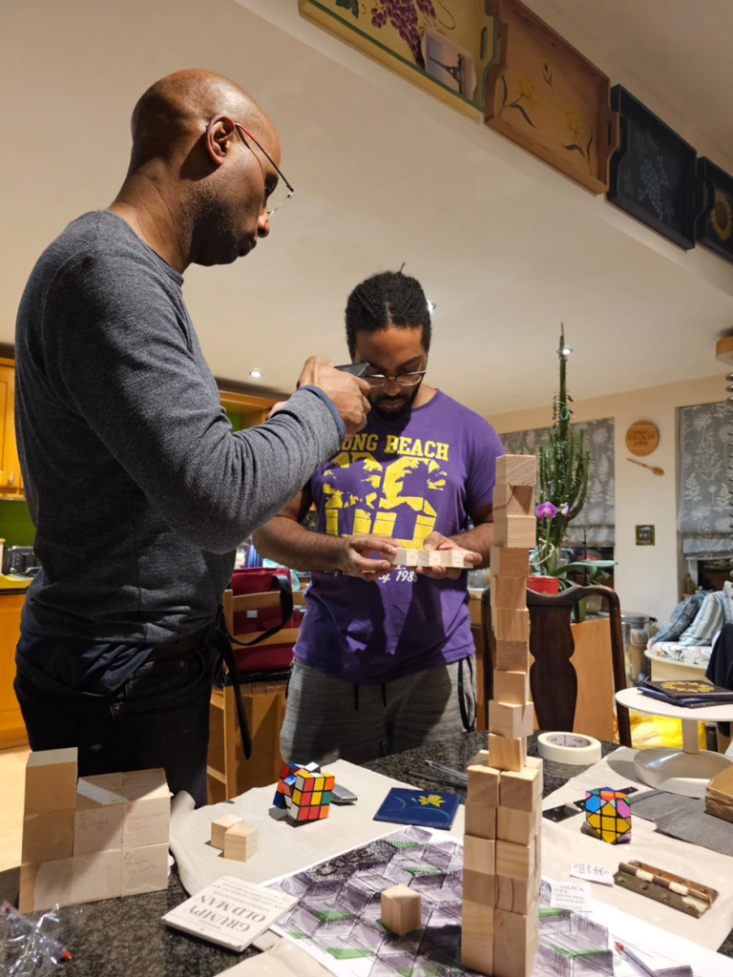

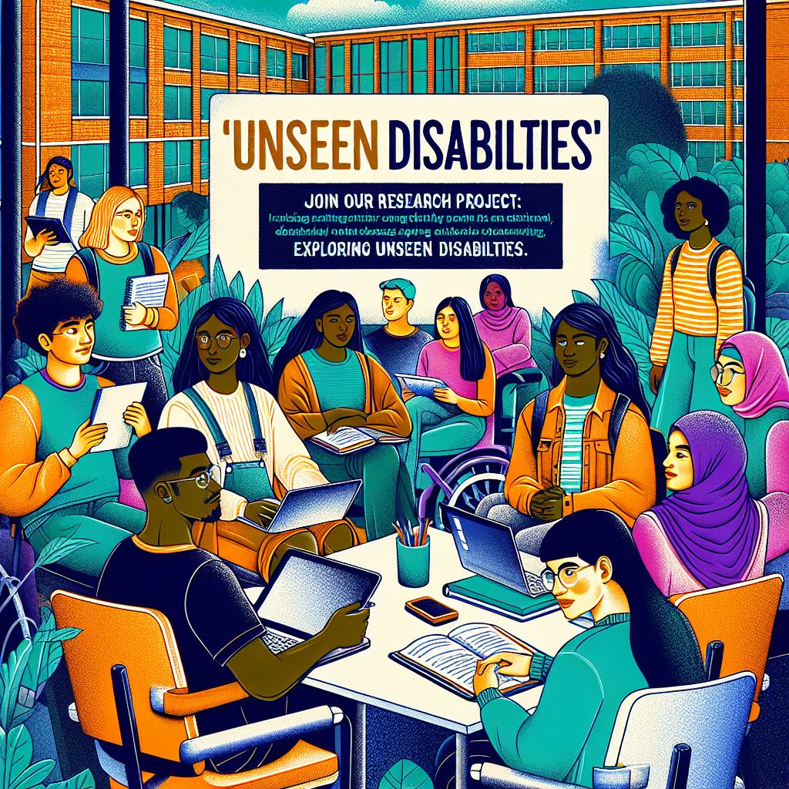

Teaching strategies for students with disabilities
Art based Research
Aim of Research
‘Object-Based Learning’ ‘Learning By Doing’ ‘Learning Through Making’
To reveal unseen disabilities; that cause barriers to inclusion and student learning
Teaching strategies
Methodology and ethical considerations
Muti-sensory Approach, Active Learning, Create an Inclusive Environment, Student-Centred Learning
‘Learning Path'. 'The Bridge’. Confidentiality, Support Systems, Respect and Empathy

Slide 4
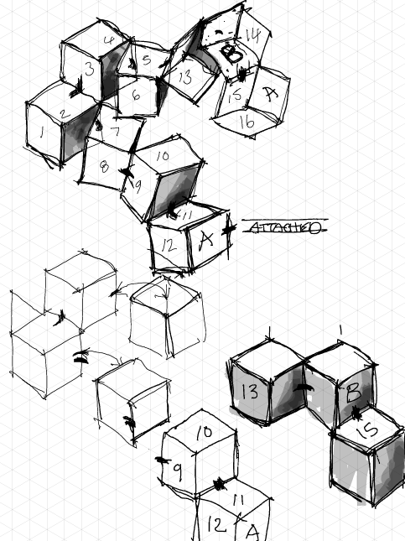
Constructing the Cube, concept, usage and rational
Intersectionality of themes
The Cube
​The cube can stimulate innovative ways of thinking; to ‘touch your written thoughts’, to hold it in your hands, an interaction of idea’s
Will be introduced as a hands-on tool to encourage open dialogue about unseen disabilities, and other challenges student may face
Feedback test
Ethical issues
Feedback from Practitioners, Teachers and Technicians to review the ‘Cube Trans Configuration Tool’
Sensitivity of the subject is of a personal nature, triggering social, political, race, culture and social structures for students and tutors/researcher

Slide 5
‘Spidey senses’, ‘who am I to do this?’, ‘oh sugar, honey, ice tea’, hitting the wall, full stop on research
End of Research Cycle 1
Feedback from Practitioners
Who am I to do this research?
End of Cycle 1 start of Cycle 2
Can be used to deliver multitude of subjects; disabilities and aid to design Creativity.
PGCert cube Michael B 26112024-edit 08012025.mp4
Am I equipped to support this type of research?
Are the questions too personal?
How do best address this?
Evaluate Research Cycle 1 material. Research data feeds into Research Cycle 2
​Action Research Project 'Unseen Disabilities'-20241113_160657-Meeting Recording.mp4

Slide 6
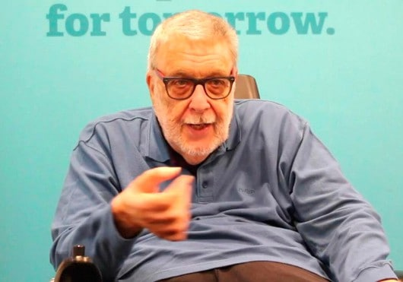
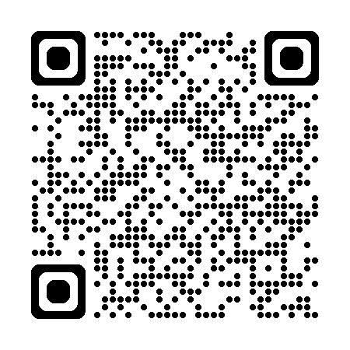
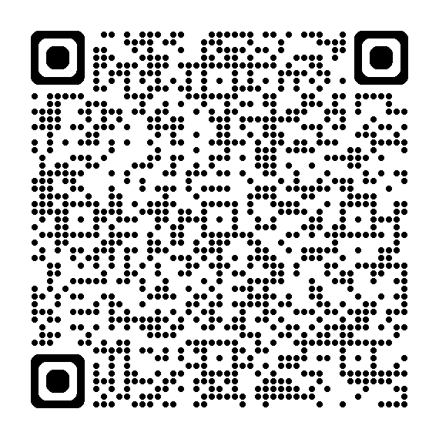
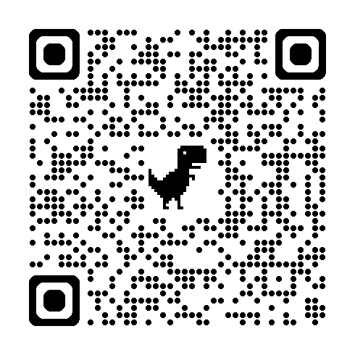
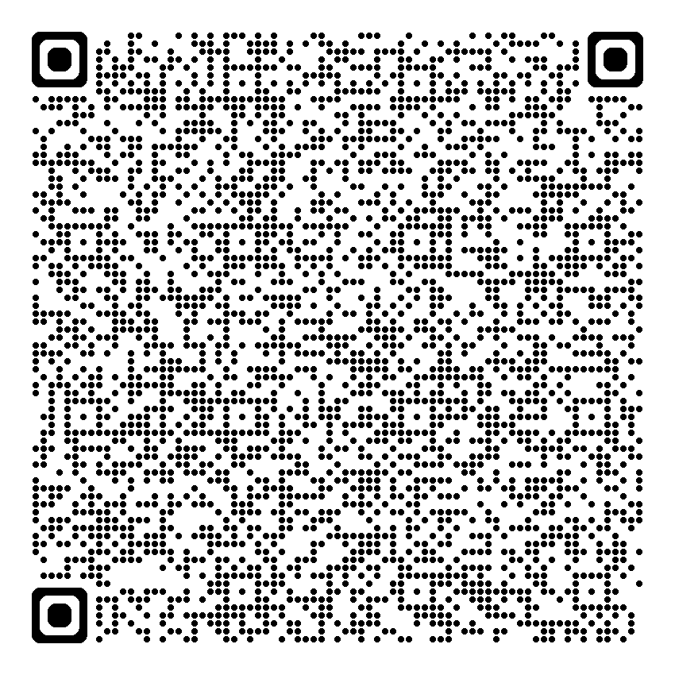
The social model
Michael Oliver​​
Live: UK parliament debates-29/11/2024
It is the failure of society to adapt to the needs of the disabled
Live: UK parliament debates assisted dying law proposal
PgCert workshop 5-6 racism in education
Action Research Project ‘unseen Disabilities​​
PgCert workshop 5-6 Racism Blog Task #3 15/06/2024 ​
Online meeting with Carys Kennedy and Michael Ste. Croix

Slide 7
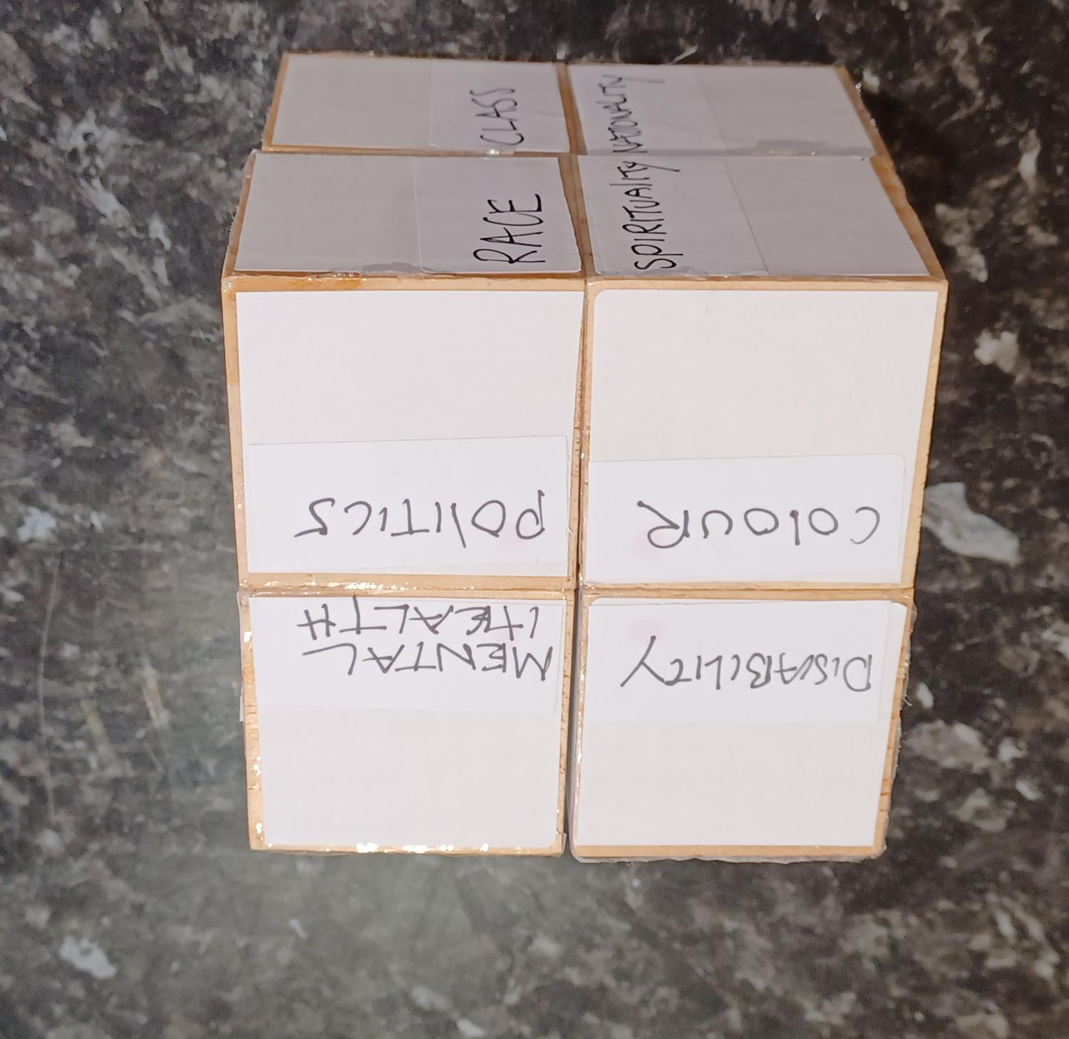
The cube
Research Cycle 1
A possible teaching tool to support seen and unseen disabilities (physical & mental), support creative design thinking
Research Cycle 2
Social Model, society to adapt to the needs of the disabled, UAL policies’ review my teaching practice
Research cycle 3, Design Larger cube for greater student engagement
A larger cube design will increase student engagement/interface, creativity and group/class discussion.​

Slide 8

Summary of my research
It has forced me to re-evaluate my teaching practice towards my students’; the importance of ‘inclusivity for all’, a principle I will adhere to. To ensure that I support all my students’ needs with awareness of the ‘intersections’ that Kemberly Crenshaw has made us aware of. Gender, sex, mental health, disabilities, faith, race intersect and can create barriers to educational learning.
There are other aspects of my research to explore that were not covered in this presentation. I am, however, more than happy to share during the Q & A session.

Slide 9


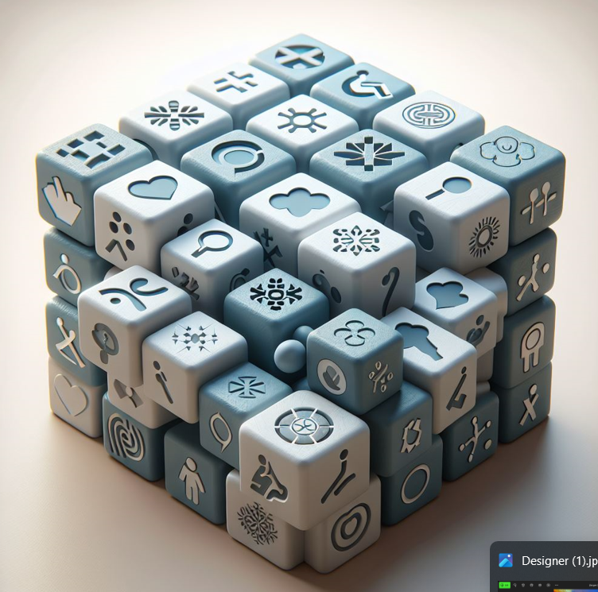

Data blocks
Cubes as data collectors.

Slide 10

Further referencing
Mapping the Margins: Intersectionality, Identity Politics, and Violence against Women of Color Author(s): Kimberle Crenshaw Source: Stanford Law Review , Jul., 1991, Vol. 43, No. 6 (Jul., 1991), pp. 1241-1299 Published by: Stanford Law Review
What is autism?https://www.mencap.org.uk/learning-disability-explained/conditions-linked-learning-disability/autism-and-aspergers-syndrome – :~:text=Autism%20is%20not%20a%20learning,also%20have%20a%20learning%20disability.
Search for: Is autism a learning disability in NHS? (Disability and Race Ade Adepitan (-2021) web: https://www.youtube.com/watch?v=KAsxndpgagU
Posted in Uncategorised | 6 Comments | Edit
Kimberle Crenshaw: What is Intersectionality?
https://www.youtube.com/watch?v=ViDtnfQ9FHc
Crenshaw, K (1991) Mapping the Margins: Intersectionality, Identity Politics and Violence against Women of Color, Source: Stanford Law Review, , Jul, 1991, Vol. 43, No. 6 (Jul.1991). pp.1241-1299
Aziz, R (1997) Feminism and the challenge of racism: Deviance or difference? In Black British Feminism, ed. Mirza, H. S. London, Routledge, pp. 70-77.Choudrey, S. (2016) Inclusivity-Supporting BAME Trans People [Online]. Gender Identity Research & Education Society, 14 February. Available from:Orr, S, & Shreeve, A 2017, Art and Design Pedagogy in Higher Education: Knowledge, Values and Ambiguity in the Creative Curriculum, Taylor & Francis Group, Milton. Available from: ProQuest Ebook Central. [1 January 2024] Created from ual on 2024-01-14:50:26
Willcocks, J & Mahon, K (2023) ‘in commerce the potential of online object-based learning activities to support the teaching of intersectional environmentalism in art and design in high education ’.’Art, Design & Communication in Higher Education’, (Volume 22) p. 187-207
Sam, C 2016 ‘How do art design technicians conceive of their role in higher education’ Spark: UAL Creative Teaching and Learning Journal Vol 1 / Issue 2 (2016) pp. 62-69
Willcocks, J & Mahon, K,-‘The potential of online object-based learning activities to support the teaching of intersectional environmentalism in art and design higher education’
Citation: Thomas, Cate. 2022. Overcoming Identity Threat: Using Persona Pedagogy in Intersectionality and Inclusion Training. Social Sciences 11: 249. https://doi.org/10.3390/ socsci11060249 Academic Editor: Nigel Parton Received: 25 March 2022 Accepted: 30 May 2022 Published: 2 June 2022

